Slide 1



The Impact of Research Workshops teaching R Software for Statistical Data Analysis to Health Sciences Students Session 4: “Learning Statistics in R”

Slide 2
Hypothesis
A PROPOSED EXPLANATION FOR A PHENOMENON.
testable statements
supported by observational evidence
serves as a basis for a single experiment
Much more data needs to be collected and experimented upon before the hypothesis can be used to predict results of other experiments and explain observations

Slide 3
Is it a hypothesis?
For every action, there is an equal and opposite reaction
No, it’s a Law
The greater number of factories in a region increases water pollution .
Yes
The Earth is a sphere.
No, it’s a fact
There is no significant change in my work habits when I get 8 and when I get 9 hours of sleep.
Yes
Individuals that smoke cigarettes and live in cities are more likely than others to have respiratory problems and increased cancer.
Yes

Slide 4
Hypothesis
Null hypothesis: THERE IS NO RELATIONSHIP BETWEEN TWO MEASURED PHENOMENA OR NO ASSOCIATION AMONG GROUPS.
Can you think of some examples?
Alternate: STATES SOMETHING IS HAPPENING, A NEW THEORY IS PREFERRED INSTEAD OF AN OLD ONE (NULL HYPOTHESIS)

Slide 5
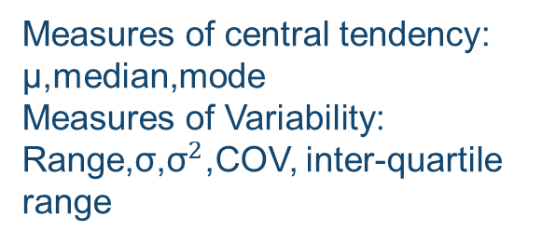
STATISTICS
Measures of central tendency: µ,median,mode
Measures of Variability:
Range,σ,${\text{σ}}^{2}$,COV, inter-quartile range
Presentation in graphs and tables
DESCRIPTIVE
PARAMETER ESTIMATION
Making conclusion from descriptive
INFERENTIAL
HYPOTHESIS TESTING

Slide 6
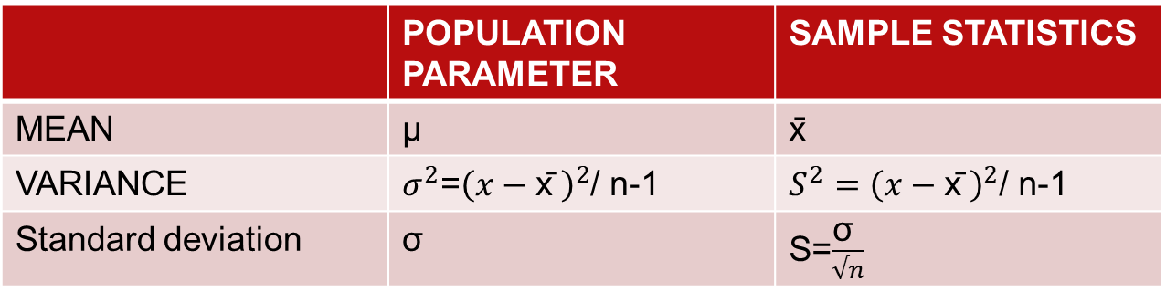
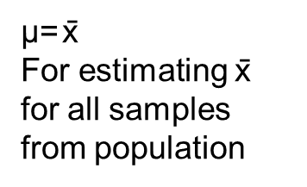
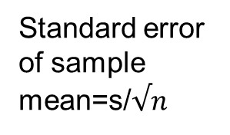
Hypothesis Testing

Slide 7
P-value
A p-value is a measure of the probability that an observed difference could have occurred just by random chance.
The lower the p-value, the greater the statistical significance of the observed difference.

Slide 8
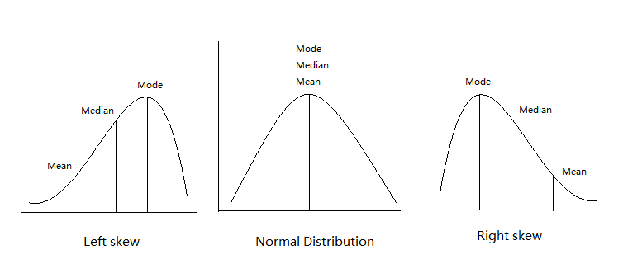
Normal distribution(X): The total area under the curve is 1. The standard normal distribution (Z) is a normal distribution with a mean of zero and standard deviation of 1
Z=(x-µ)/σ

Slide 9
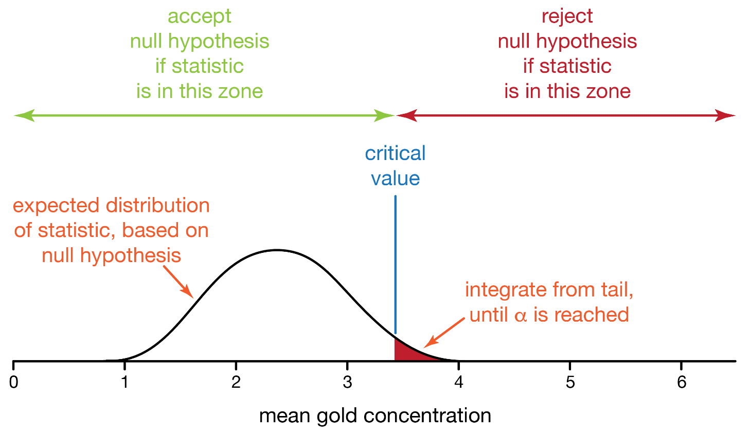

Slide 10

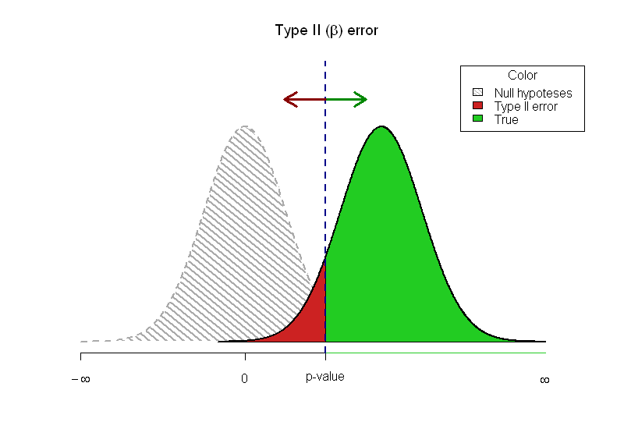
TRUTH OF NULL HYPOTHESIS
 | TRUE | FALSE
REJECTED | (TYPE 1) α | 1-β (POWER)
FAILED TO REJECT | CONFIDENCE (1-α) | (TYPE 2 ) β
OUR DECISION

Slide 11
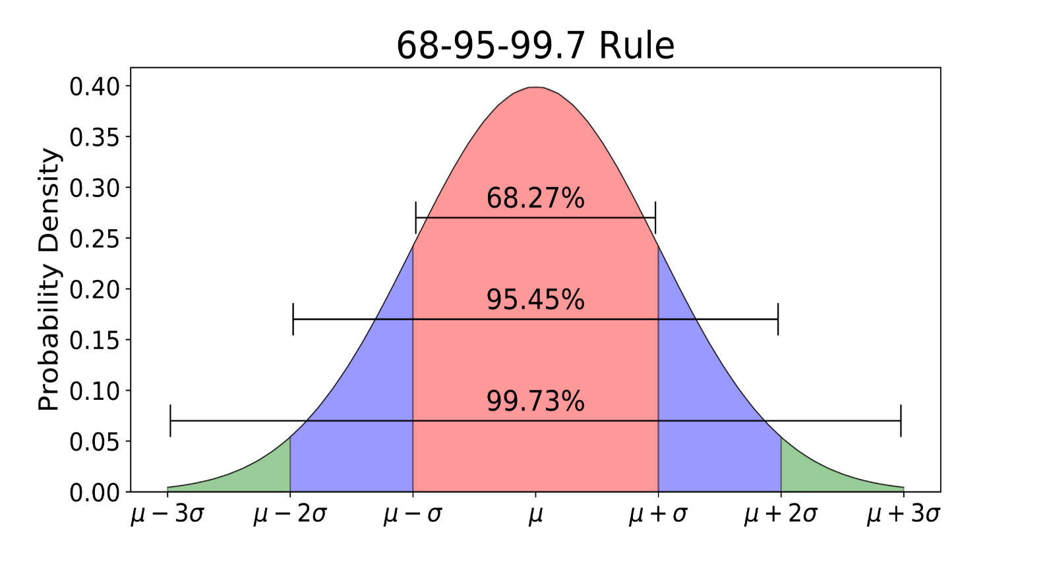
A Confidence Interval is a range of values about which we are fairly sure that our true value lies in it.

Slide 12
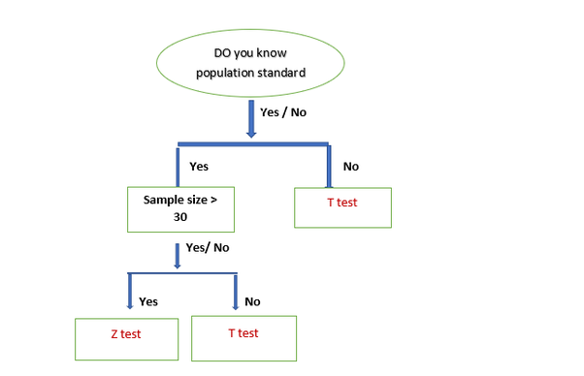

Slide 13
T-Test
One –sample
Dependent Paired sample
Independent

Slide 14
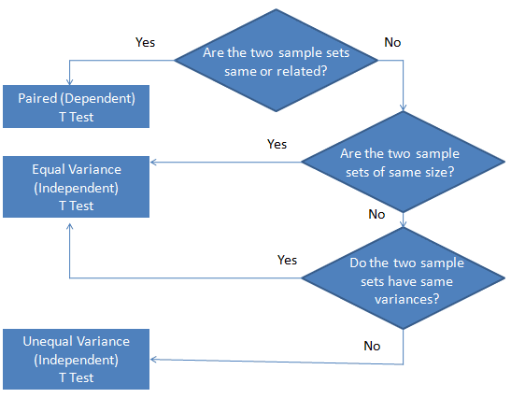

Slide 15
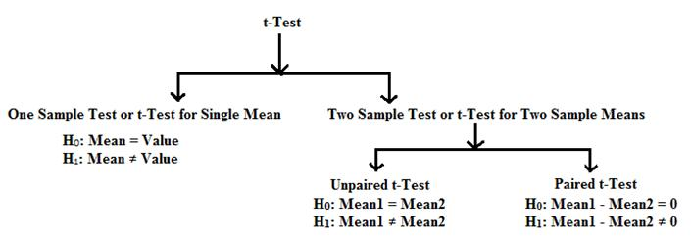

Slide 16
A chi-square test for independence compares two variables in a contingency table to see if they are related

Slide 17
Read The question carefully!
The average Hb of normal women =13.The doctor thinks pregnant women are anemic. He takes a sample of 19.
X=10.72632
S=2.752139
Are pregnant women anemic?

Slide 18
Which test will you use to test hypothesis and why?
T-test!
Remember: T-test is used to test for sample size<30
Which type of T-test will you use?
One sample
Use R to perform this test.

Slide 19
Is there any association between alcohol consumption and smoking in pregnant women?
Smoking | Alcohol consumption-None | Alcohol Consumption-Low | Alcohol Consumption -medium | Alcohol Consumption -high | Total
Smoker | 290 | 540 | 305 | 129 | 1264
Non-Smoker | 410 | 679 | 428 | 240 | 1757
Total | 700 | 1219 | 733 | 369 | 3021

Slide 20
Which test will you use & why?
Chi-Square: Need to compare two independent variable in contingency table
Use R to perform this test.

Slide 21
Which test will you use & why?
The heights of adult female living in an area are normally distributed with mean =155.9861 cm and standard deviation of 17 cm. Sample size of 49 was taken from street A for ABD survey .
According to ABD survey ,Adult females living in street A have mean height of 170 cm. Is the mean height of adult females in street A different than general population?
Z-Test
Use R to perform this test.

Slide 22
Car | Garage 1 | Garage 2
1 | 7.6 | 7.3
2 | 10.2 | 9.1
3 | 9.5 | 8.4
4 | 1.3 | 1.5
5 | 3 | 2.7
6 | 6.3 | 5.8
7 | 5.3 | 4.9
8 | 6.2 | 5.3
9 | 2.2 | 2
10 | 4.8 | 4.2
11 | 11.3 | 11
12 | 12.1 | 11
13 | 6.9 | 6.1
14 | 7.6 | 6.7
15 | 6.6 | 7.5
Same cars’ prices were estimated by 2.Are these prices different than each other?

Slide 23
Which test will you use & why?
T-test :
Dependent paired sample-Same sample
Use R to perform this test.

Slide 24
TEST THE HYPOTHESIS FOR MEAN DIFFERENCE IN KNOWLEDGE ABOUT PREGNANCY B/W TWO GROUPS.ASSUME VARIANCE IS SAME.
 | Health Education | No Health education
No. of mothers | 73 | 73
Mean score | 47.64384 | 21.70548
Sd | 17.58659 | 14.47599

Slide 25
Which test will you use & why?
T-test –Independent-Equal Variance
Use R to perform this test.

Slide 26
References
https://www.nasa.gov/pdf/371711main_SMII_Problem23.pdf
https://www.quora.com/Why-do-we-use-t-test-and-z-test
http://strata.uga.edu/8370/lecturenotes/pvaluesConfidenceIntervals.html
http://dataanalyticsedge.com/2017/05/20/t-test/
https://www.mathsisfun.com/data/confidence-interval.html
CHSME

Slide 27
Contact us at :
spie.medtech@gmail.com
Javerya.hassan@scholar.aku.edu

